Slide 1


TOURNAMENT TREE
If there are p players in a tournament, then the tournament tree/selection tree will have p leaf nodes/external nodes and p-1 internal nodes. The tournament tree is an application of the binary heap data structure hence it is a complete binary tree. They are versatile and can handle various data types.
Two Types of Tournament Trees:
1. Winner Trees: the nodes at a particular level stores the winner of the two nodes at the level below it (minimum value among its children). Winner trees are useful in ranking scenarios, like sports tournaments, where you need to quickly identify the best performer with the lowest score or fastest time.
2. Looser Trees: the nodes at a particular level stores the winner of the two nodes at the level below it (minimum value among its children). In a Loser tree, the tournament’s winner is stored at the top, and the second place (runner-up) is the child of it.
One advantage of loser trees compared to winner trees is that it is sufficient to examine the nodes on the path from leaf nodes to the root node for restructuring the tree in looser trees. To form a looser tree, we have to create winner tree at first. We will store looser of the match in each internal node. Loser Trees can be used to find the runner up of a tournament
time complexity is O(n).

Slide 2
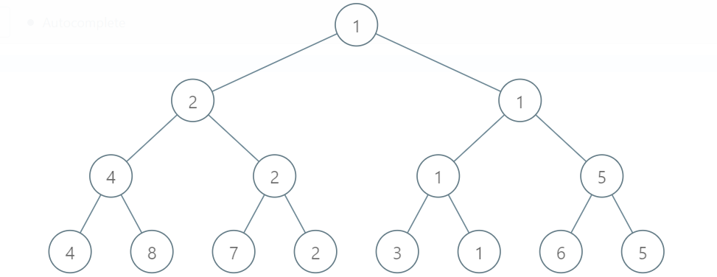
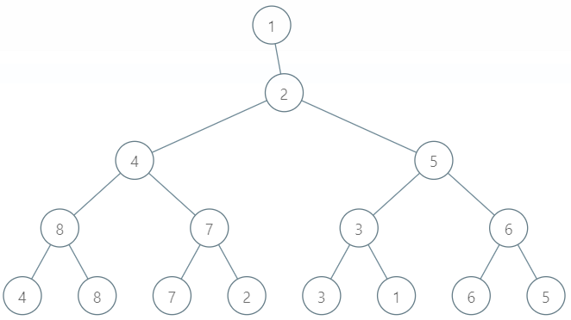
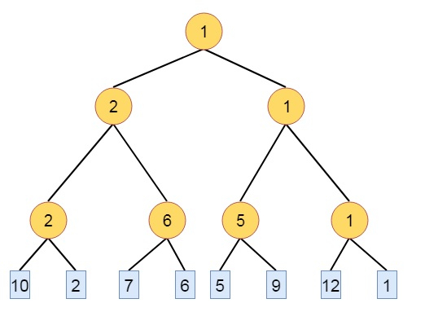
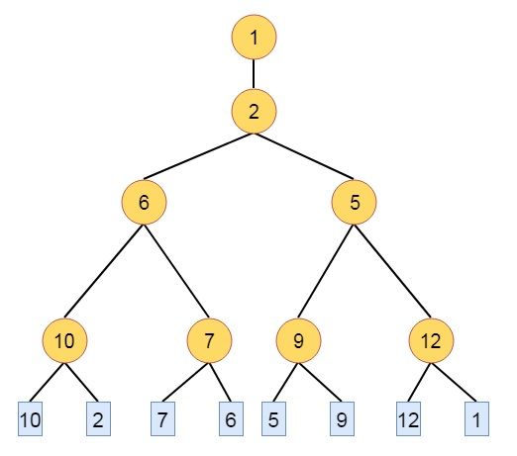
Winner tree Loser tree
Winner tree Loser tree

Slide 3
public static void main(String args[]){
int[] arr = new int[n];
Arrays.sort(arr);
Sytsem.out.print(arr[-1]);//winner
System.out.print(arr[-2]);//runner up
}

